Slide 1

Firebase Authentication with Spring boot + Vue Js

Slide 2
Set up firebase admin to spring boot application

Slide 3
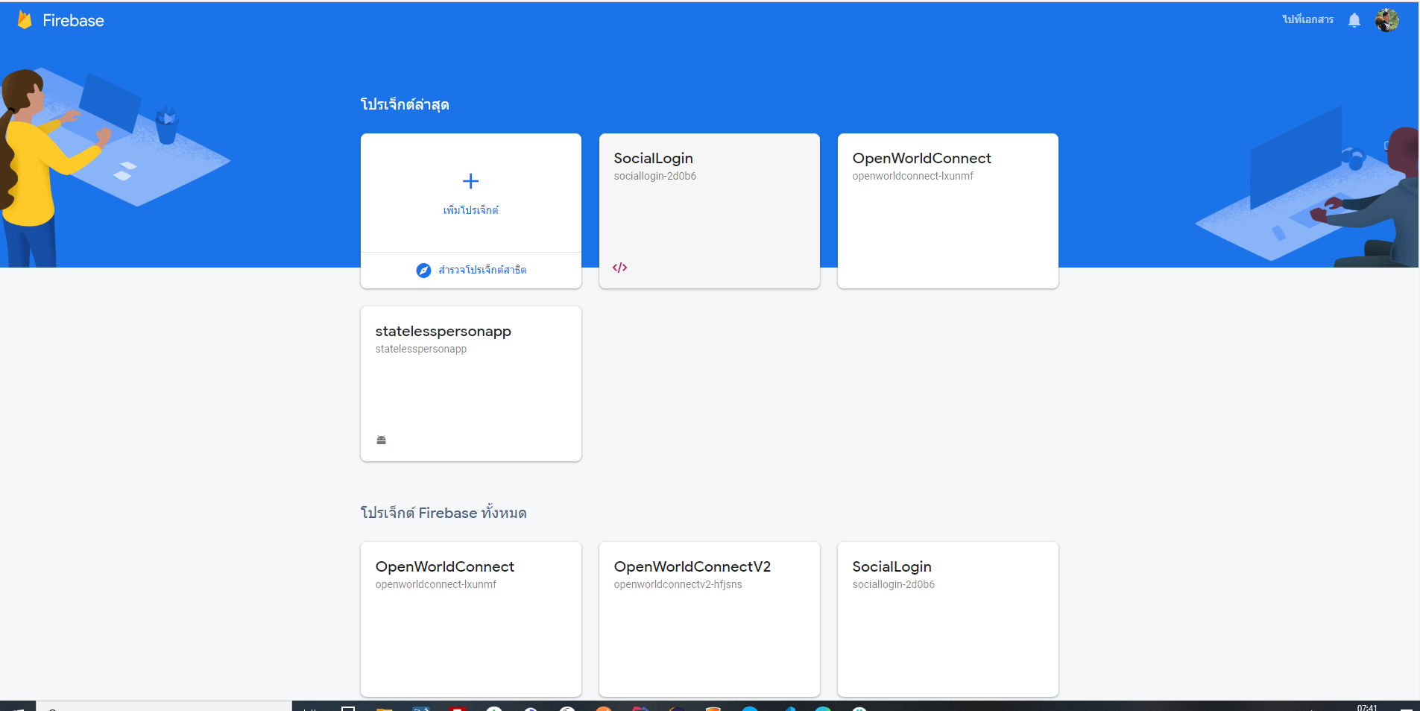
Create Project On Firebase[1]

Slide 4
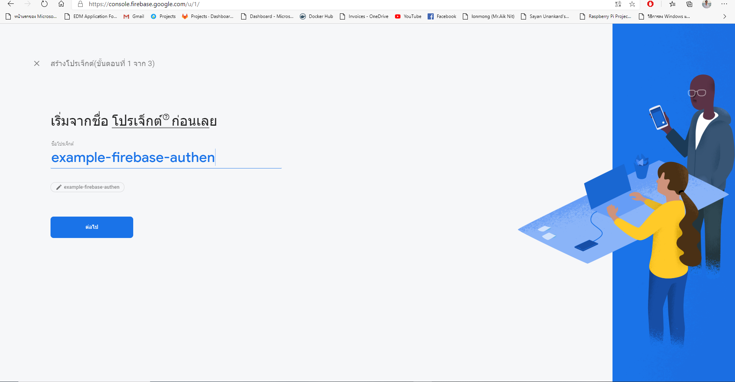
Create Project On Firebase[2]

Slide 5
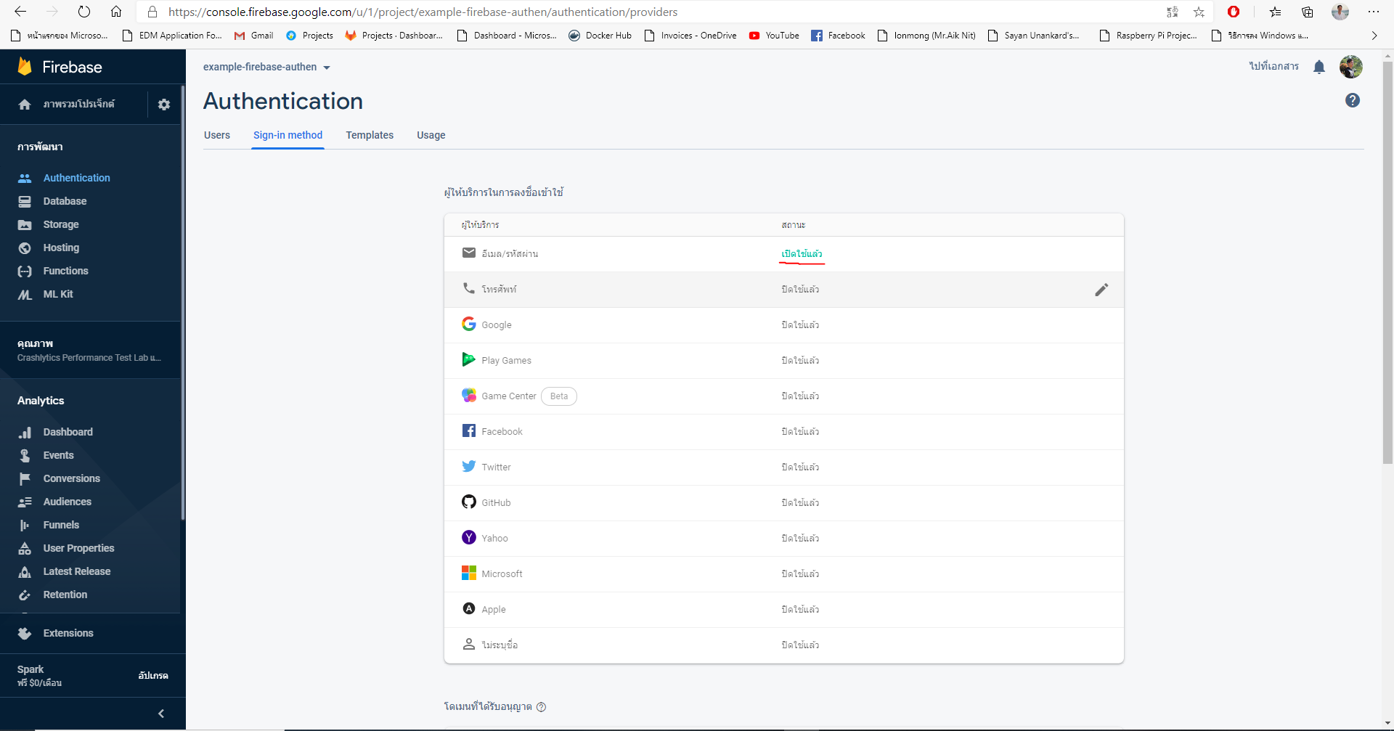
Enable function authen firebase

Slide 6
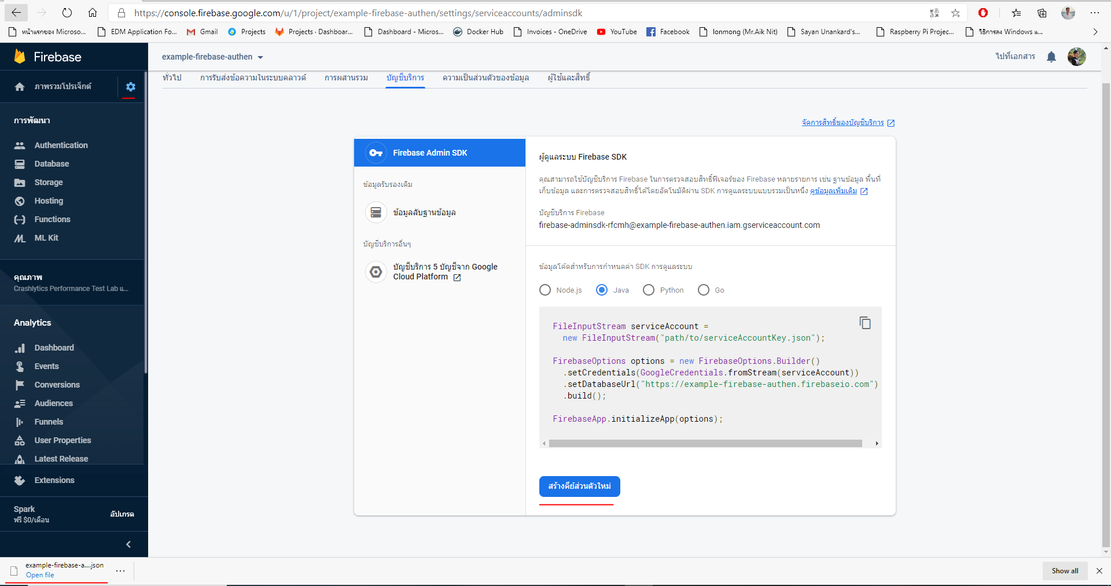
Download config json file

Slide 7
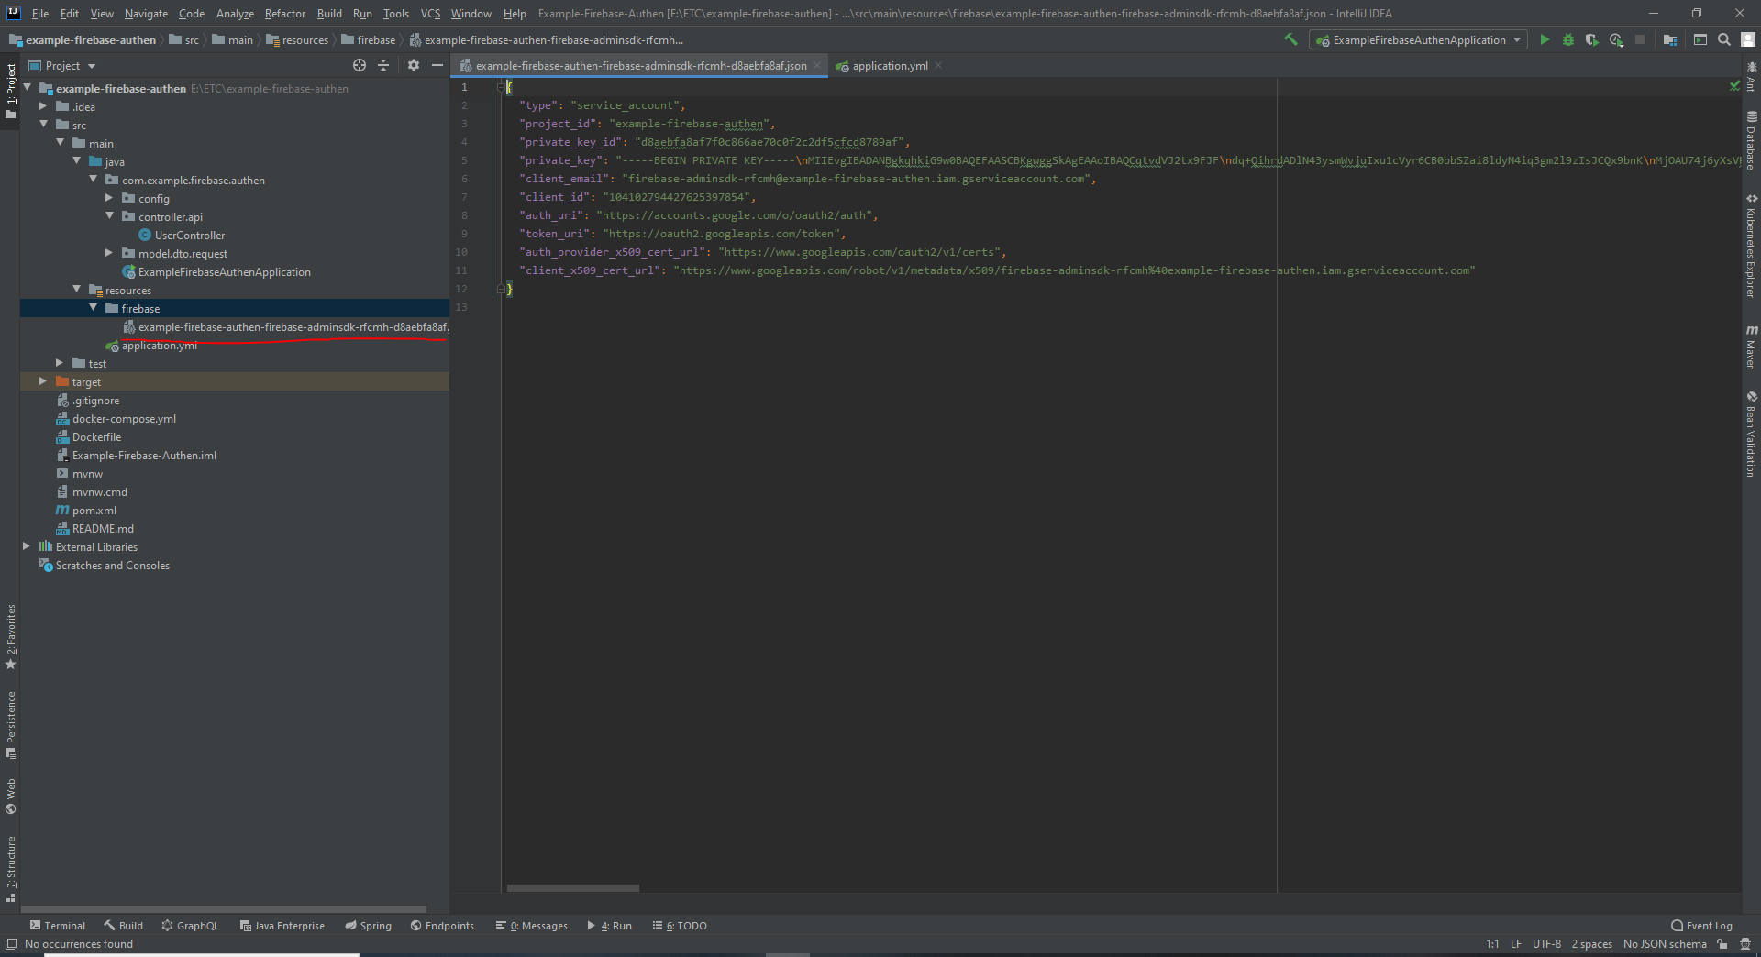
Create folder in application spring boot and past config json file

Slide 8
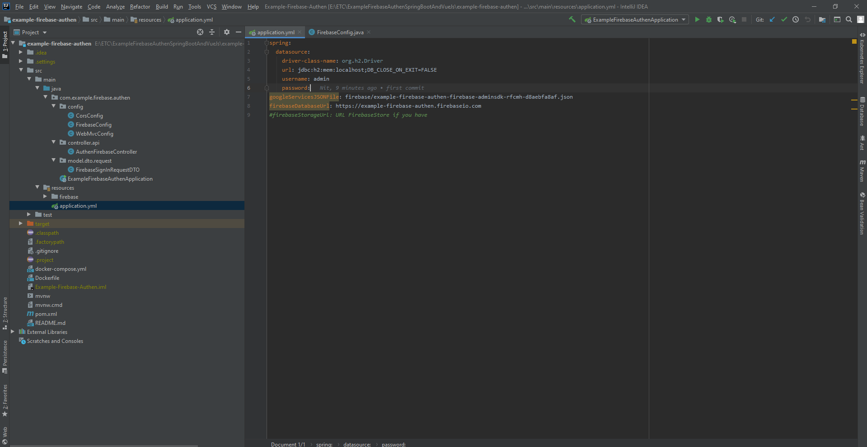
Config path json file in application in file application.yml

Slide 9
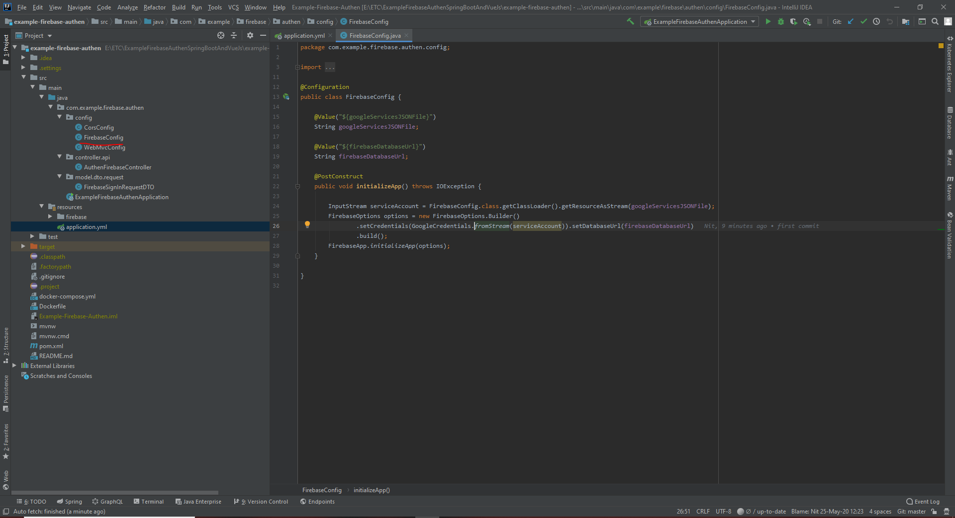
Create Initial app class for firebase

Slide 10
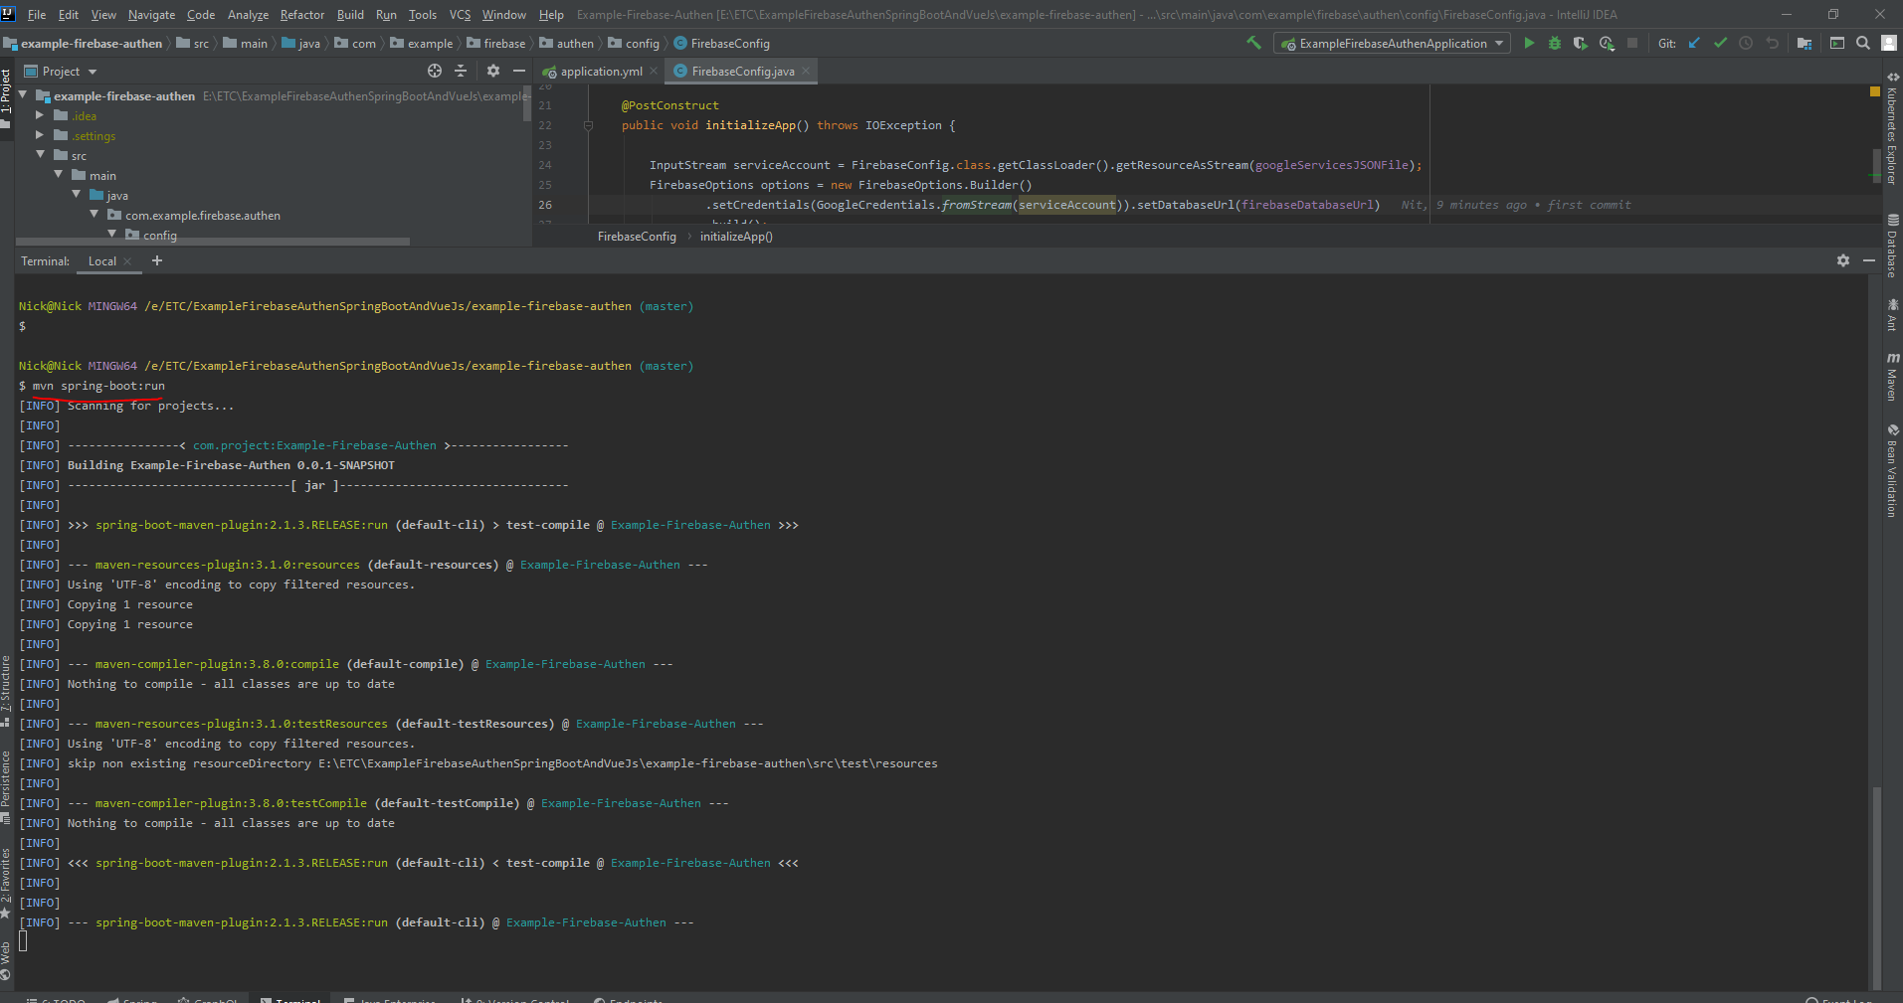
Run project

Slide 11
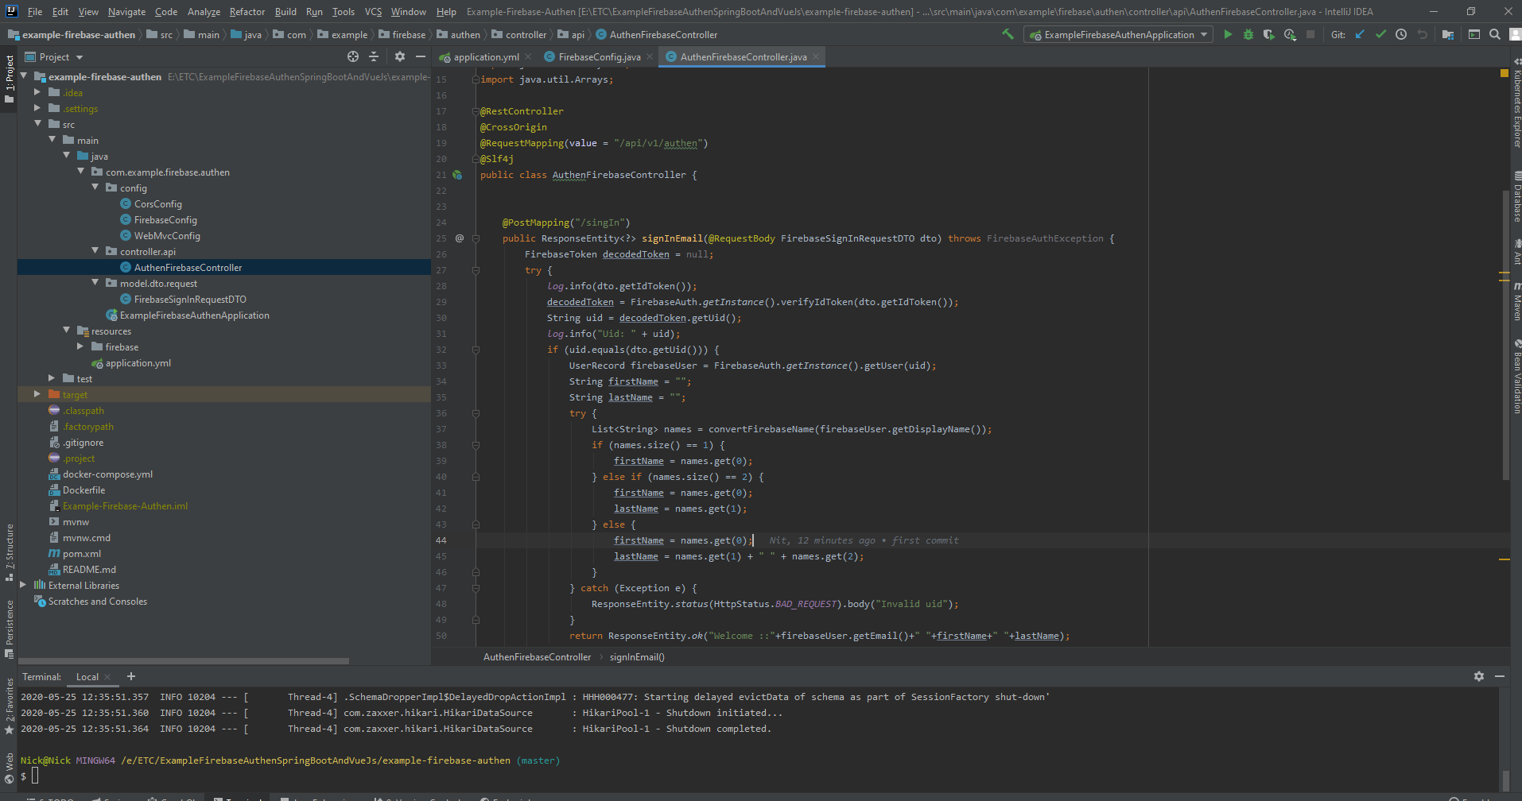
Path API

Slide 12
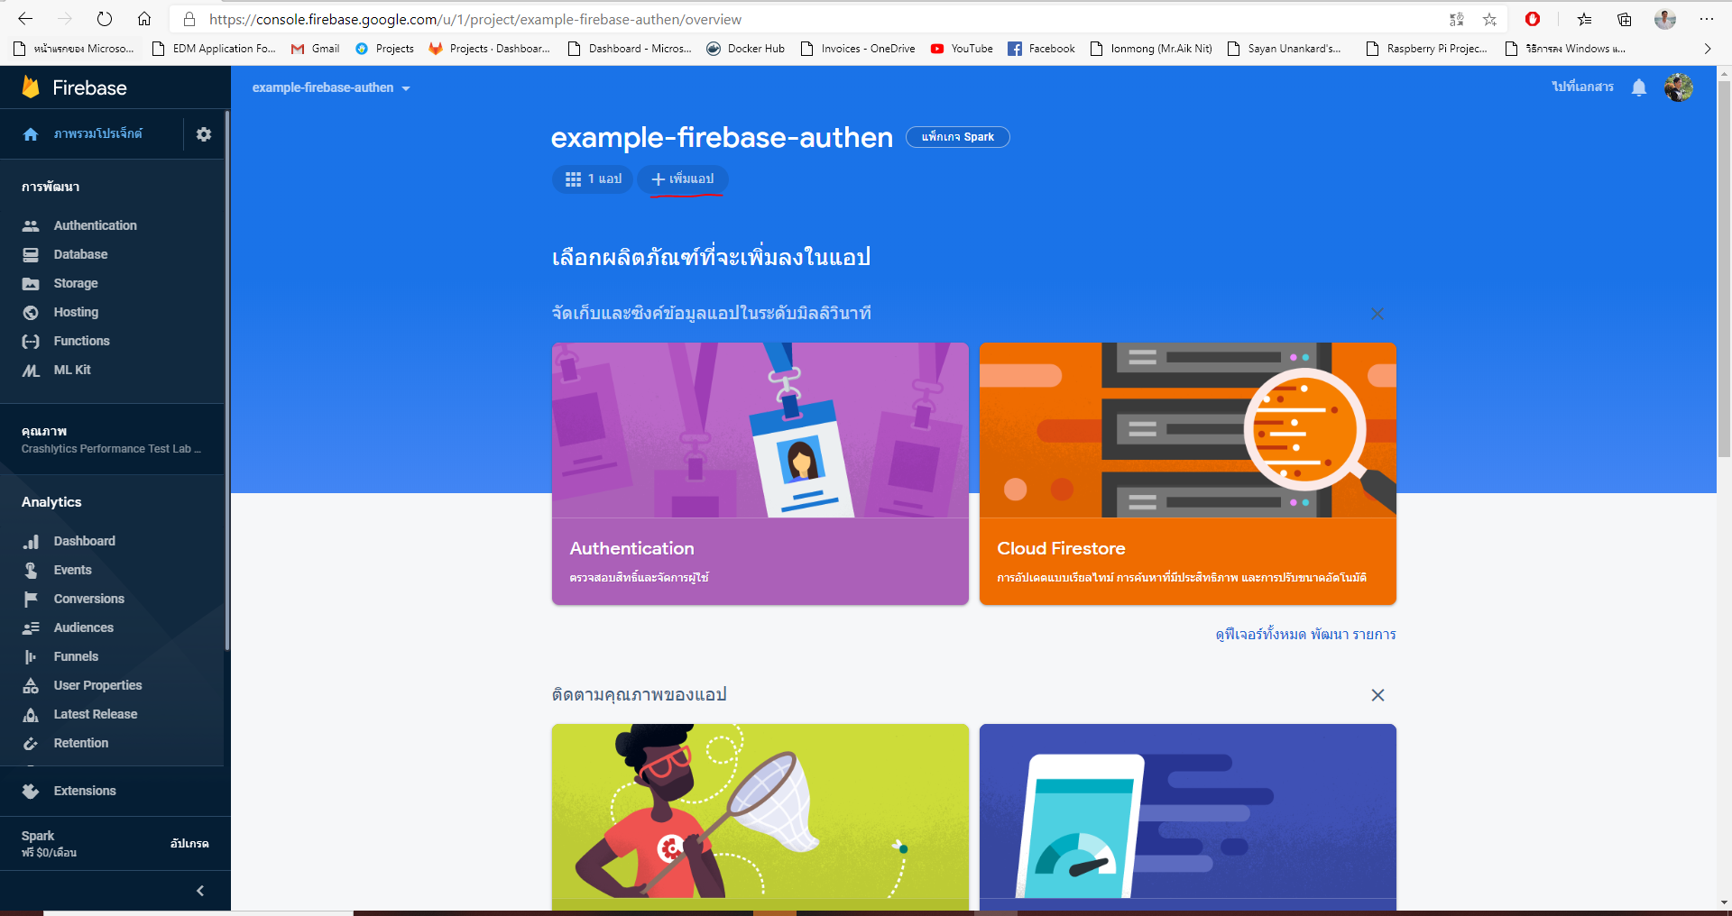
Config frontend and run frontend

Slide 13
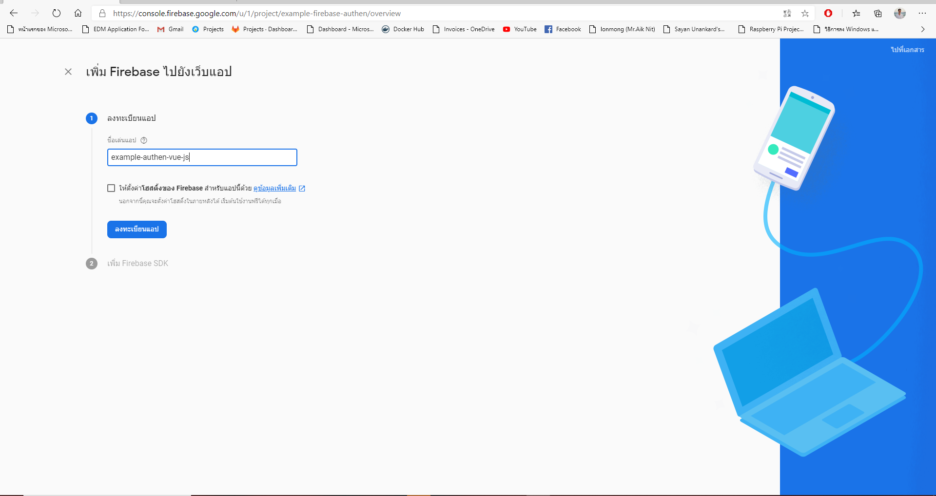
Register Application

Slide 14
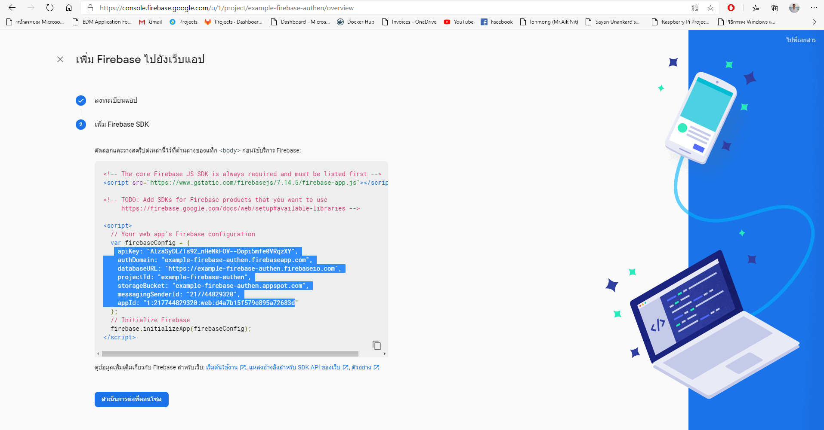
Copy config file

Slide 15
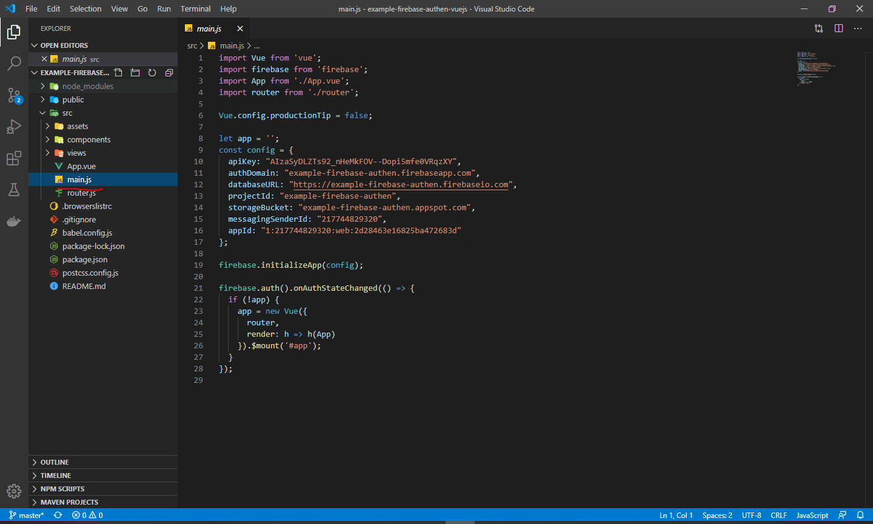
Create and past config file

Slide 16
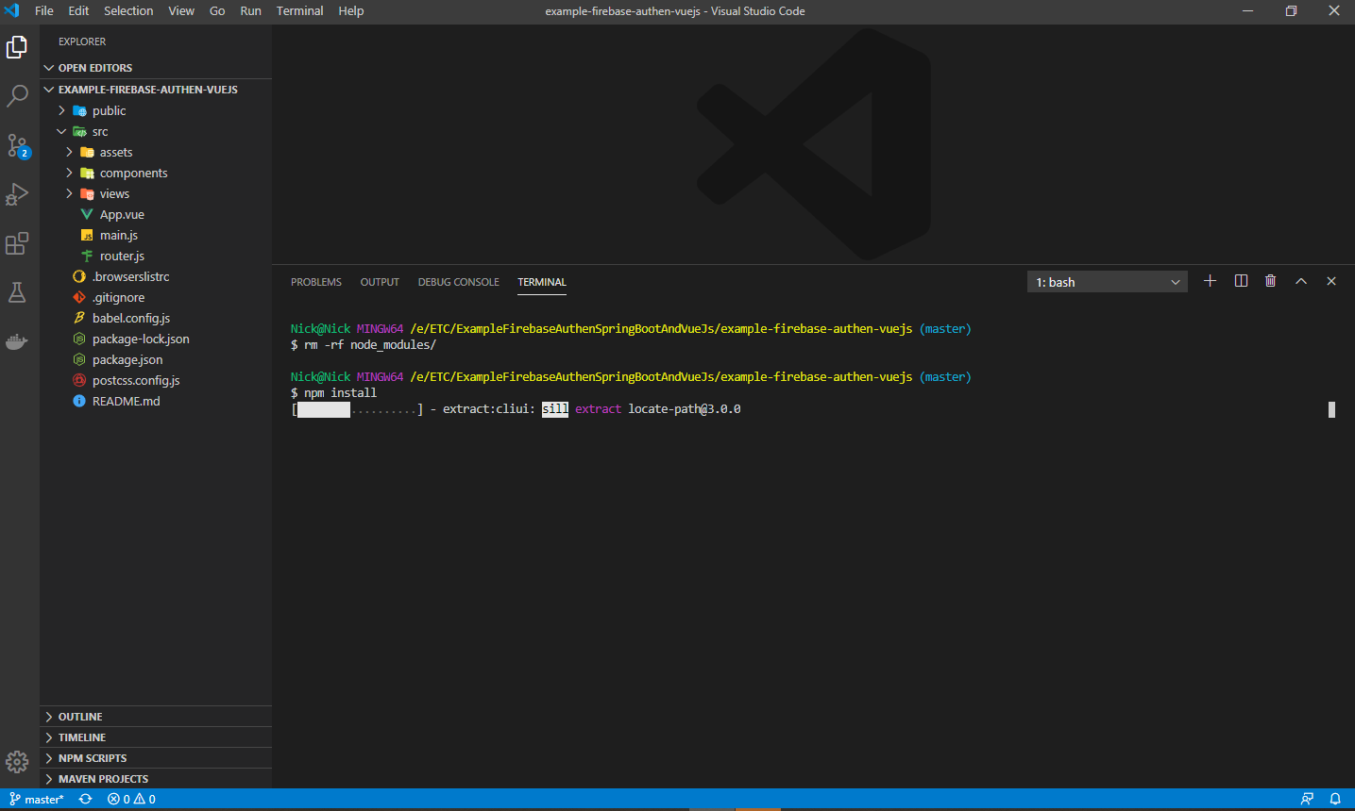
Install Package

Slide 17
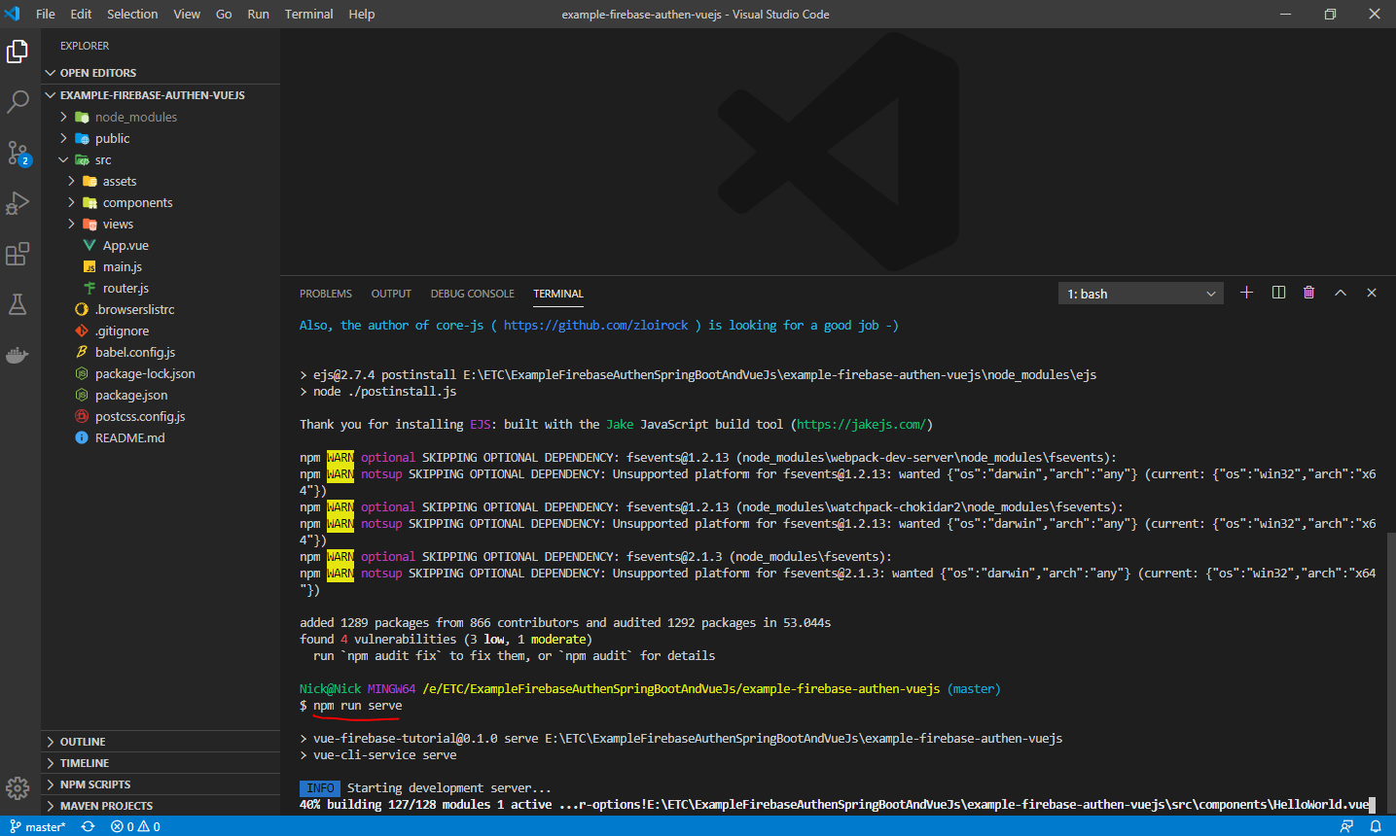
Run

Slide 18
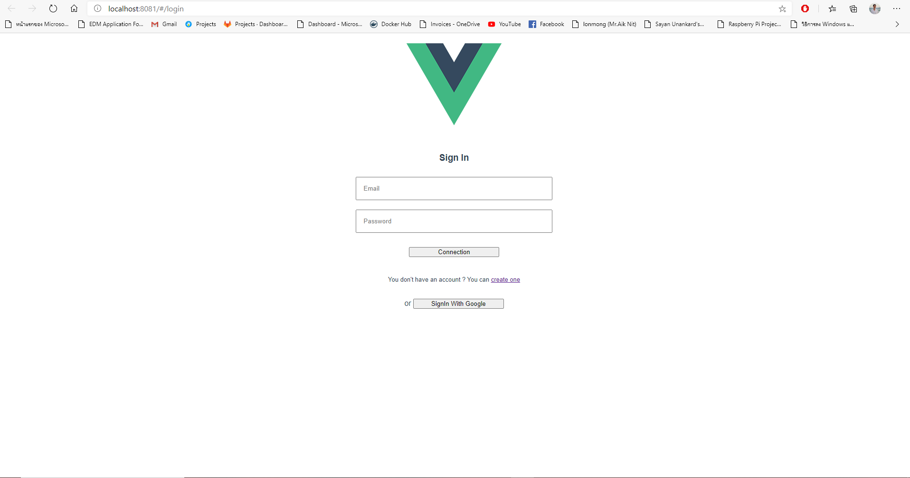
Finish

